Slide 1
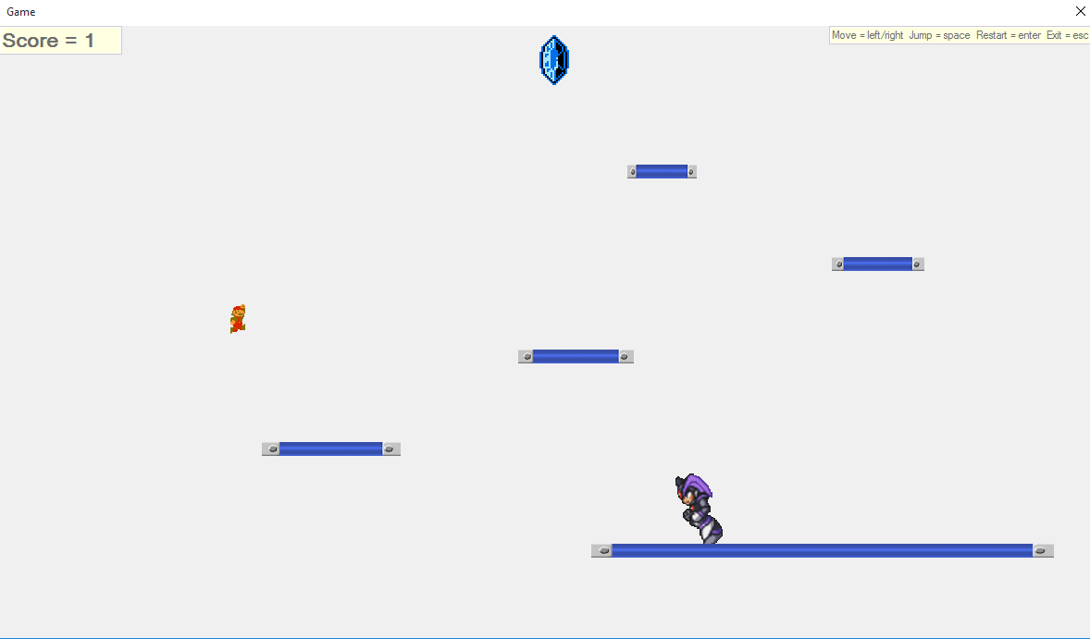
Jumping Dude
“Jumping Dude” is C#-based Windows Form Game , with two heroes : main hero – “The Dude” and enemy hero – “Sonic” and with well-known “Super Mario” sound effects.

Slide 2
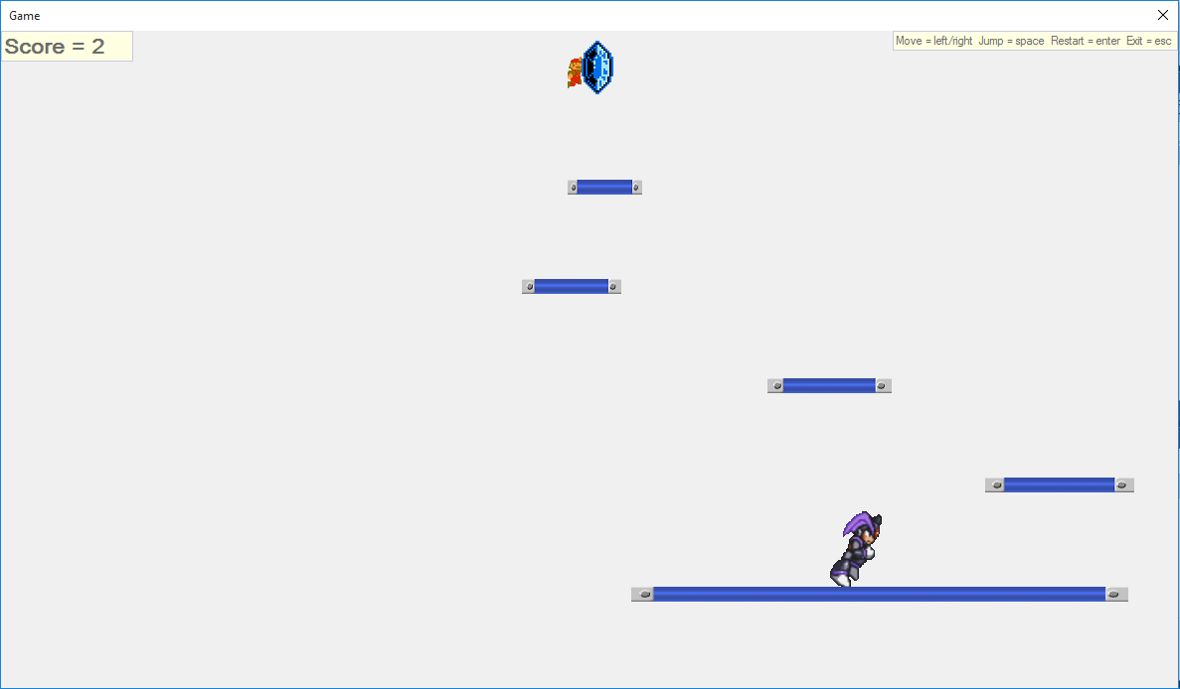
Goal
The goal of the game is to reach the “Diamond” on top of the screen by avoiding getting caught by the enemy hero, which increases the score by one point each time.

Slide 3
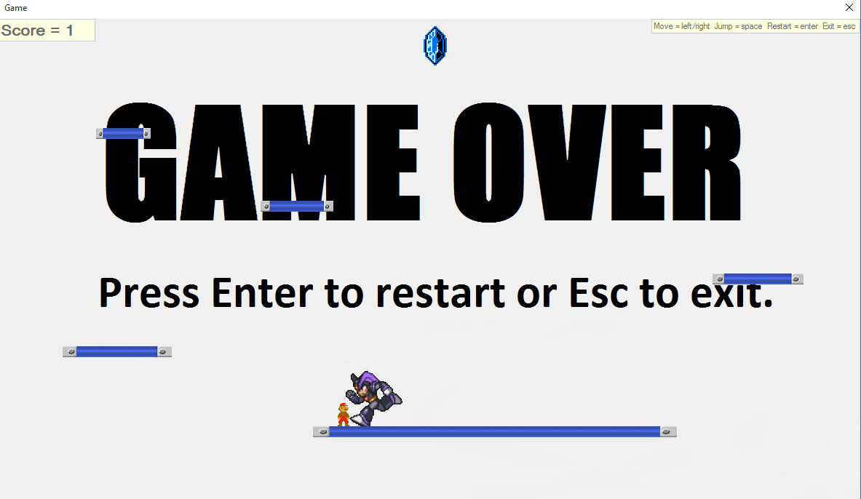
Platforms’ speed gets higher while the score is rising. The game ends if the main hero gets caught by the enemy hero.

Slide 4
Team “Felucia”
Members:
Mirela Damyanova (mirela95)
Alexander Peychev (Mayblitz)
Ивайло Ставрев (orion133)
Hashim Solakov (Dargo)
Lachezar Beevski (beevsky)
Emiliyan Georgiev (ilmisha)
Denis Elovikov (Den_is)

